Slide 1


Slide 2
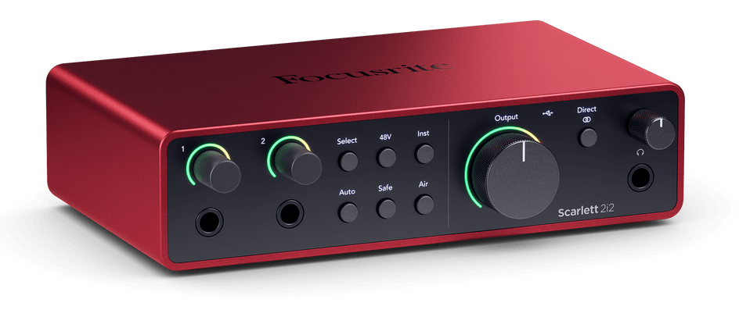
Embedded Software Development
is not
Desktop Software Development

Slide 3
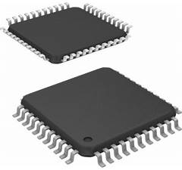
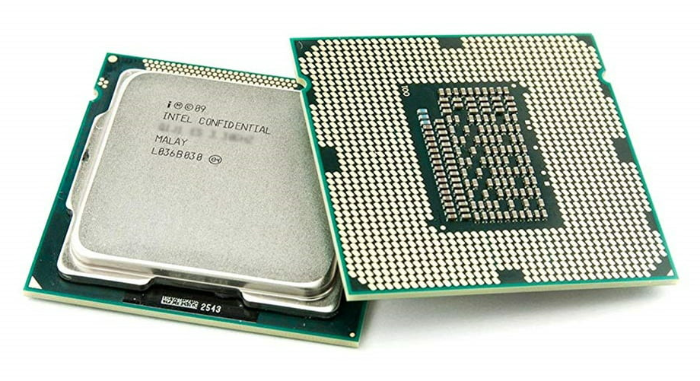
Microcontrollers
are not
Typical Microprocessors

Slide 4
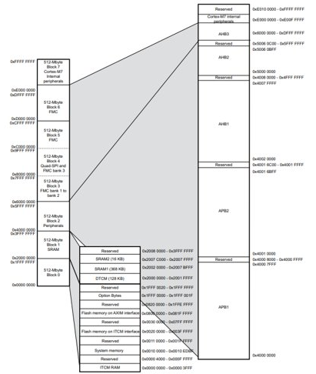
Programming is harder when you don't have much memory.

Slide 5
Word Size
Memory Arch
The range of available devices is very broad!
Memory Size
Clock Speed
Instruction Set
Vendor
Peripheral Set
Package
Device Family

Slide 6
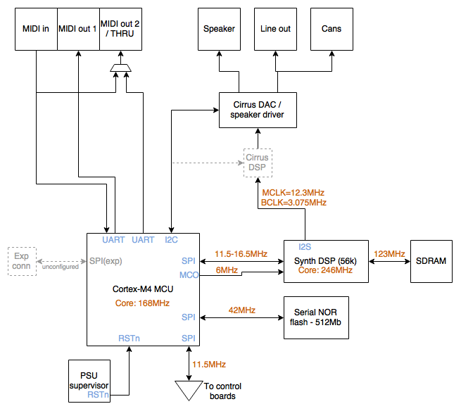
Build up a picture of what the MCU needs to do

Slide 7

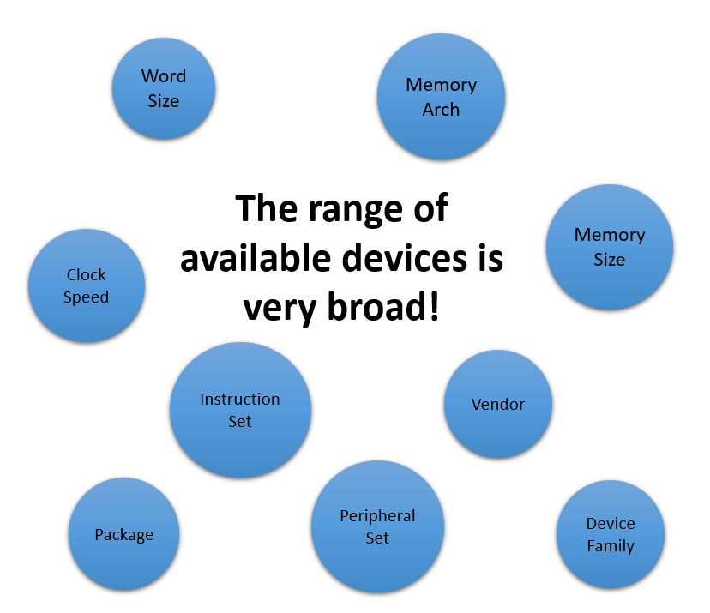



Choose a device, thinking about how we should configure it

Slide 8
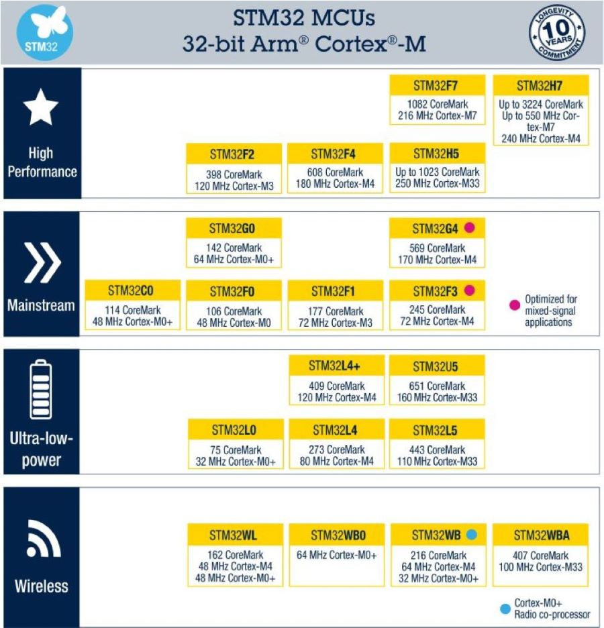
Pick a family…

Slide 9
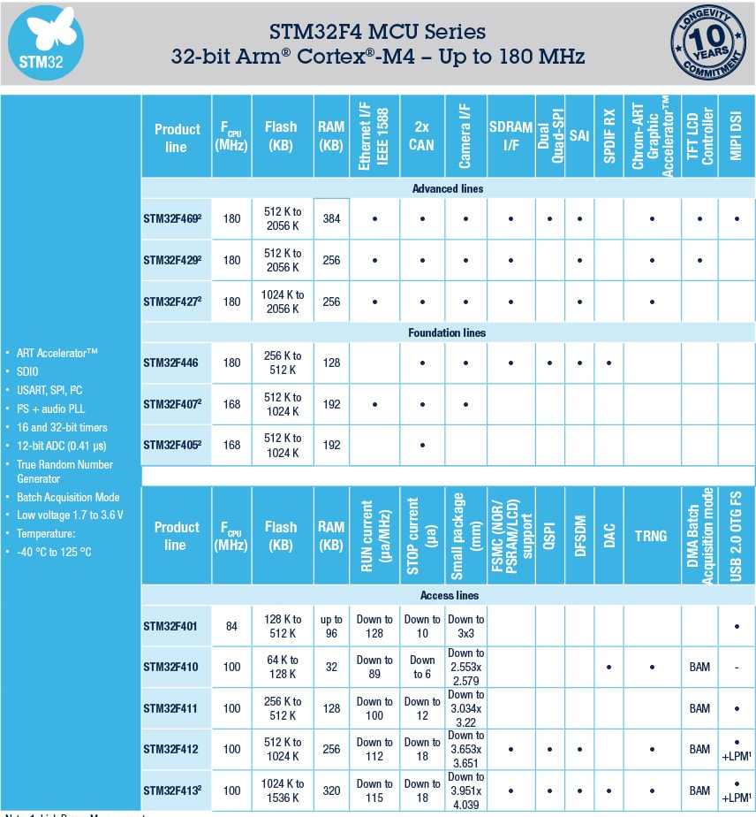
Pick a device…
Notes:
Screengrab from ST website

Slide 10
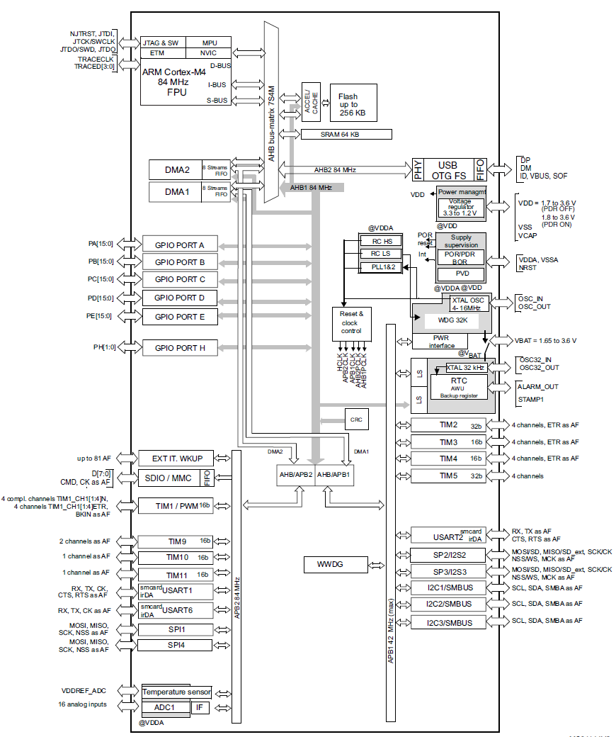
…and decide how to set it up
Notes:
Screengrab from ST website

Slide 11
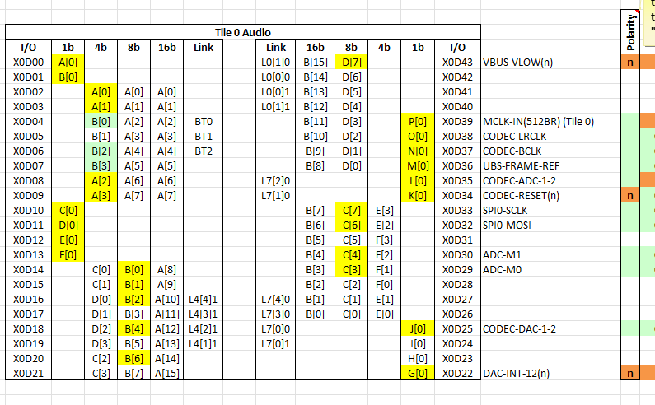
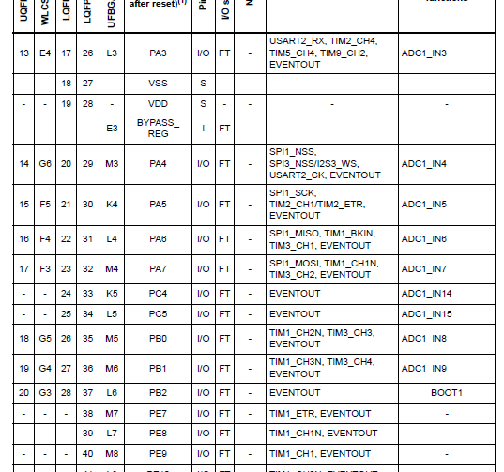
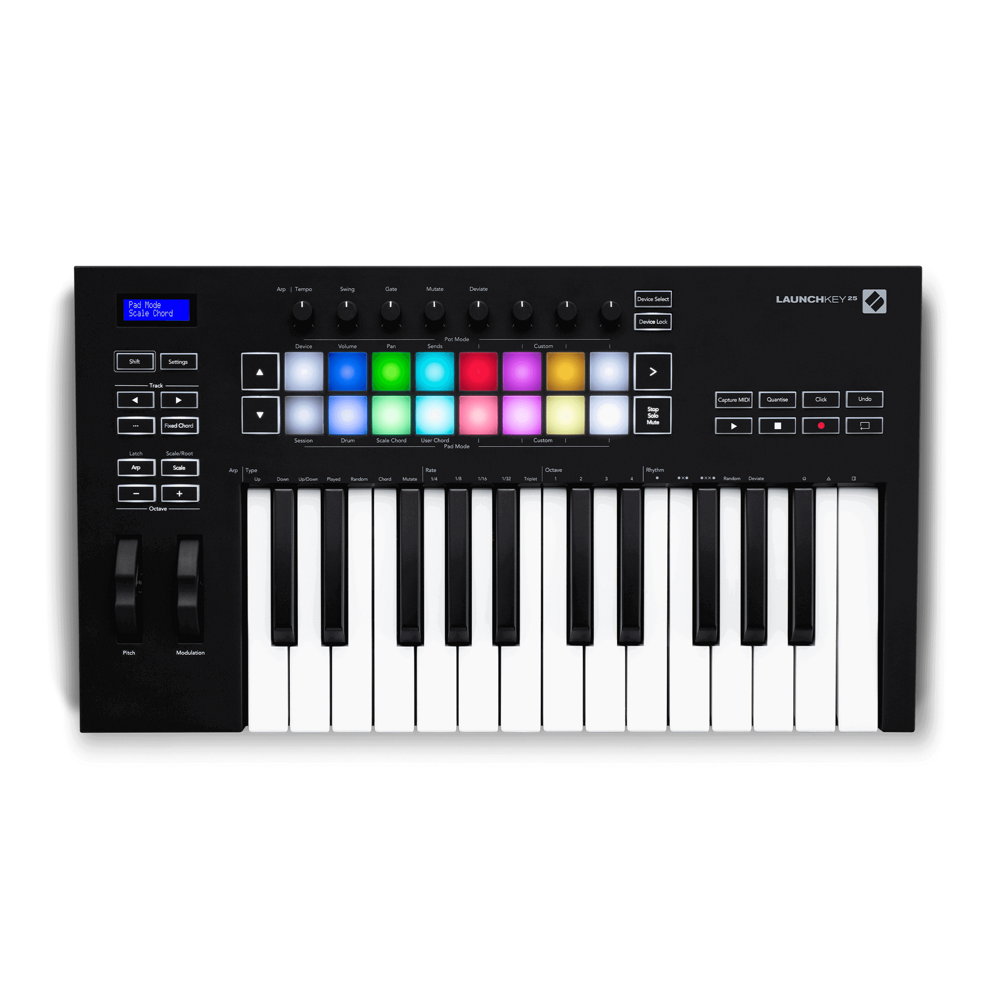
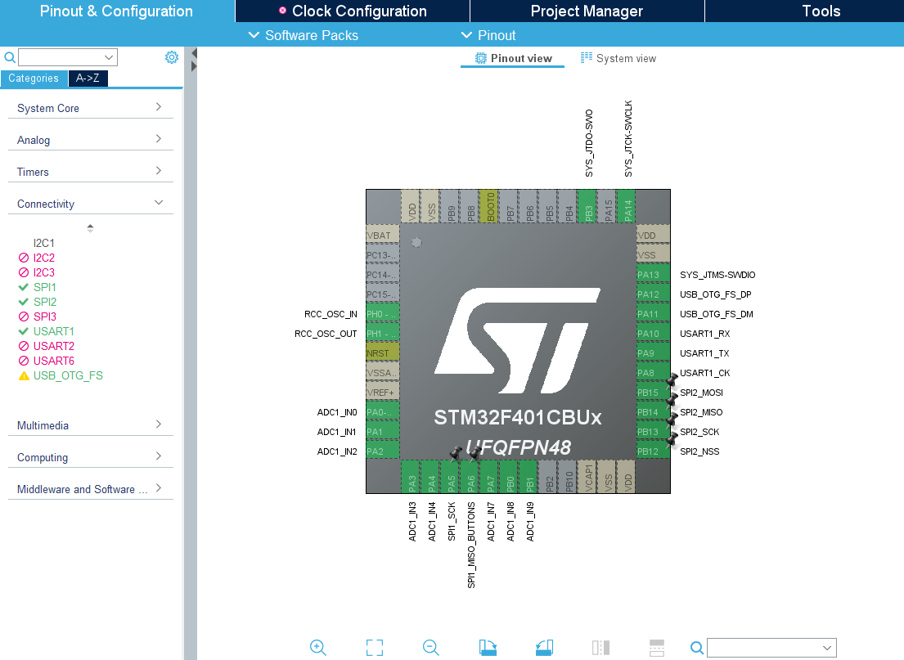
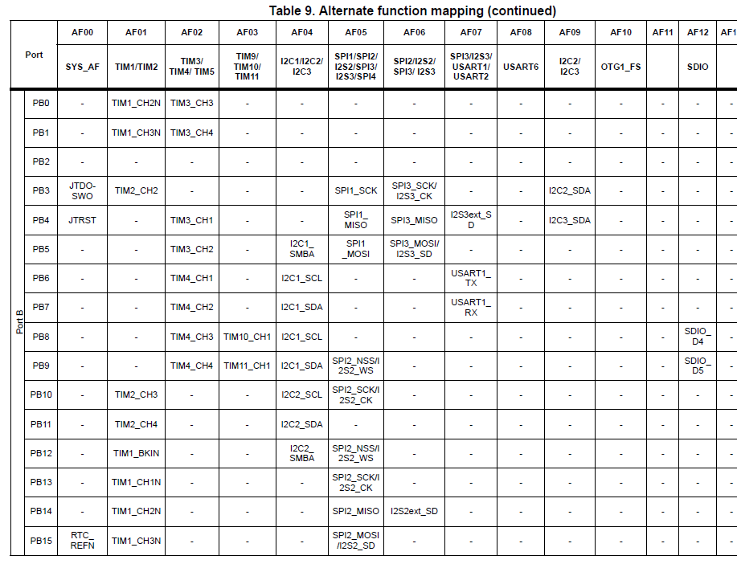
Notes:
Screengrab from ST website

Slide 12

What could possibly go wrong?
Notes:
Stock image from pixabay, free to use without attribution https://pixabay.com/photos/chemistry-baby-experiment-science-5632654/

Slide 13
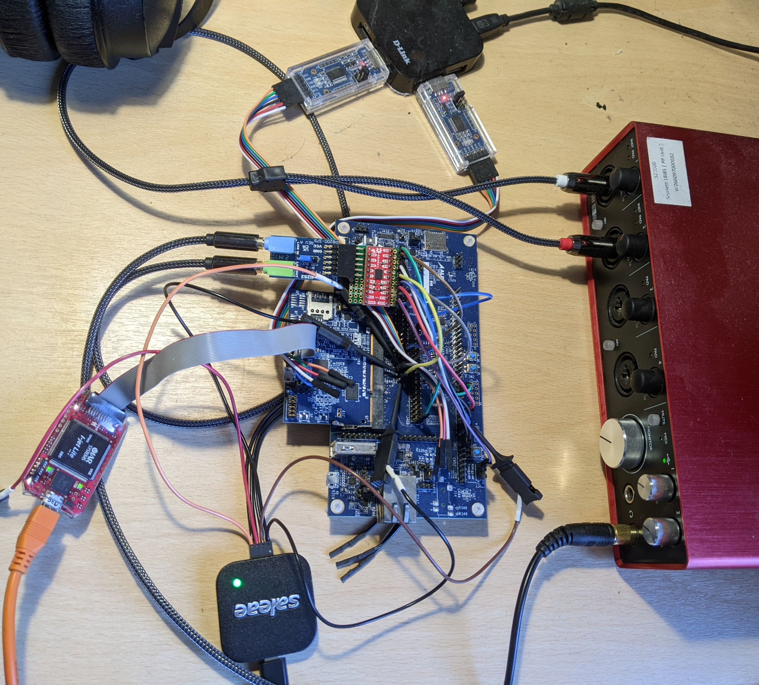
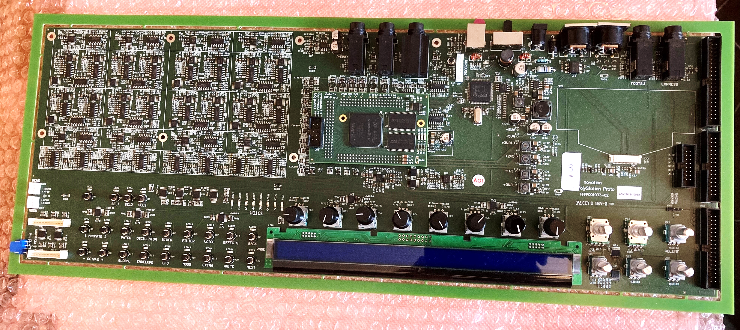
Just enough hardware to get started

Slide 14
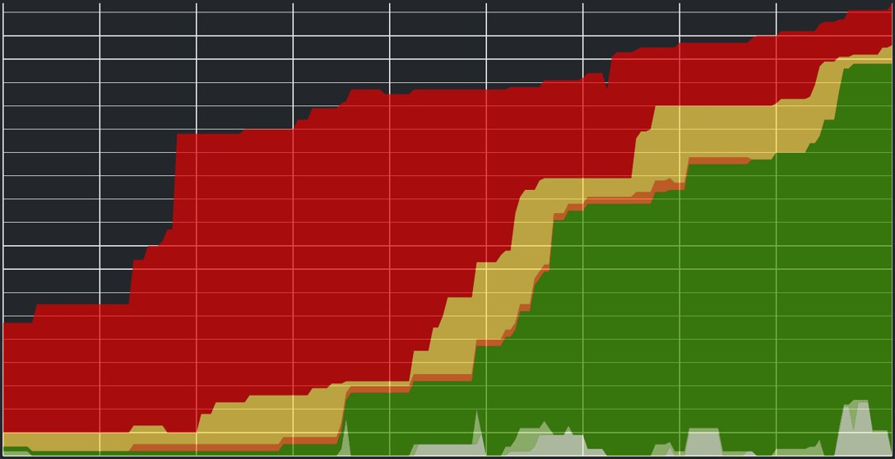
Firmware engineers
join
multi-disciplinary teams...

Slide 15
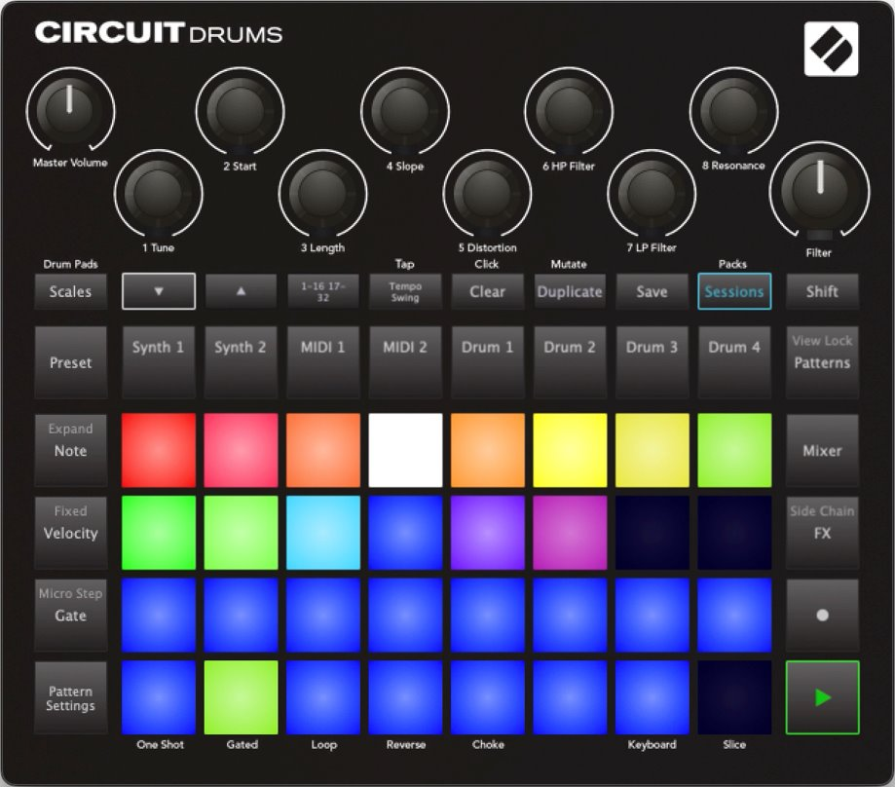
..but must also couple tightly to software & hardware development

Slide 16




Debugging together – choose tools that keep the barrier to entry low
Notes:
Stock image from pixabay, free to use without attribution https://pixabay.com/photos/young-people-group-friends-3575167/

Slide 17
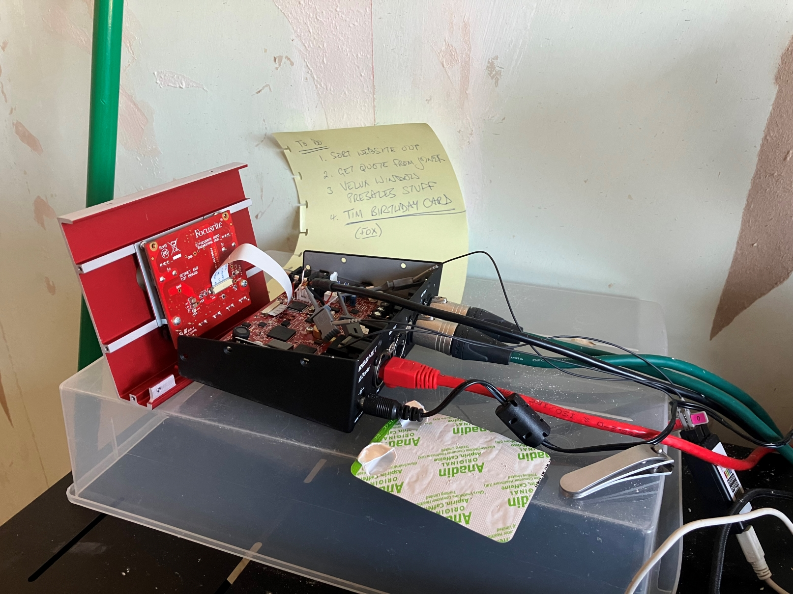
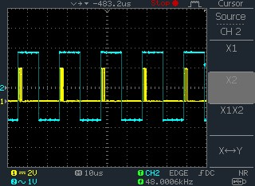
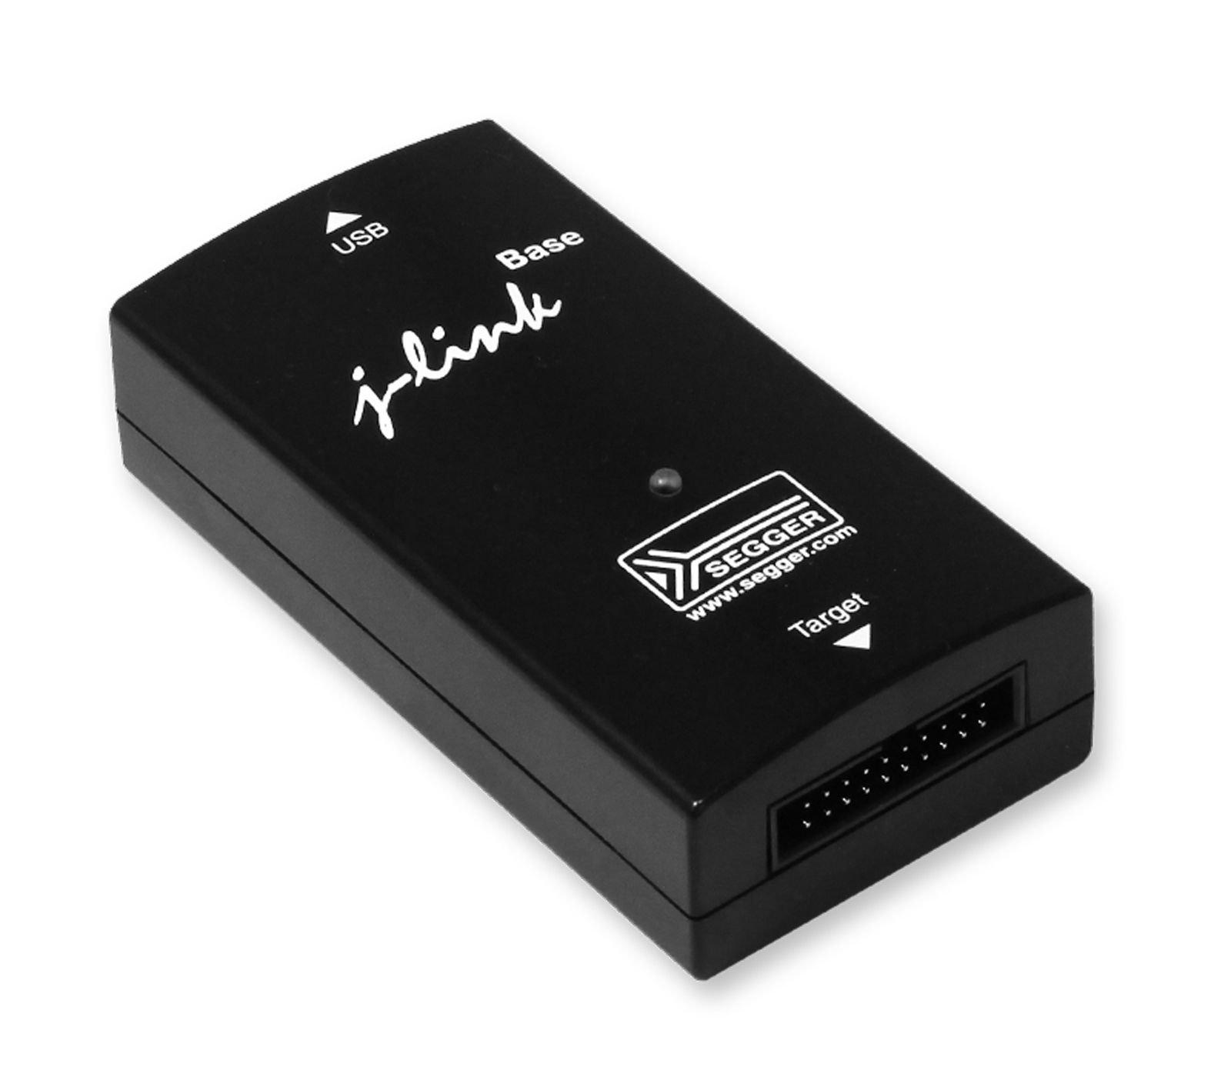
Finding out what’s going on inside

Slide 18
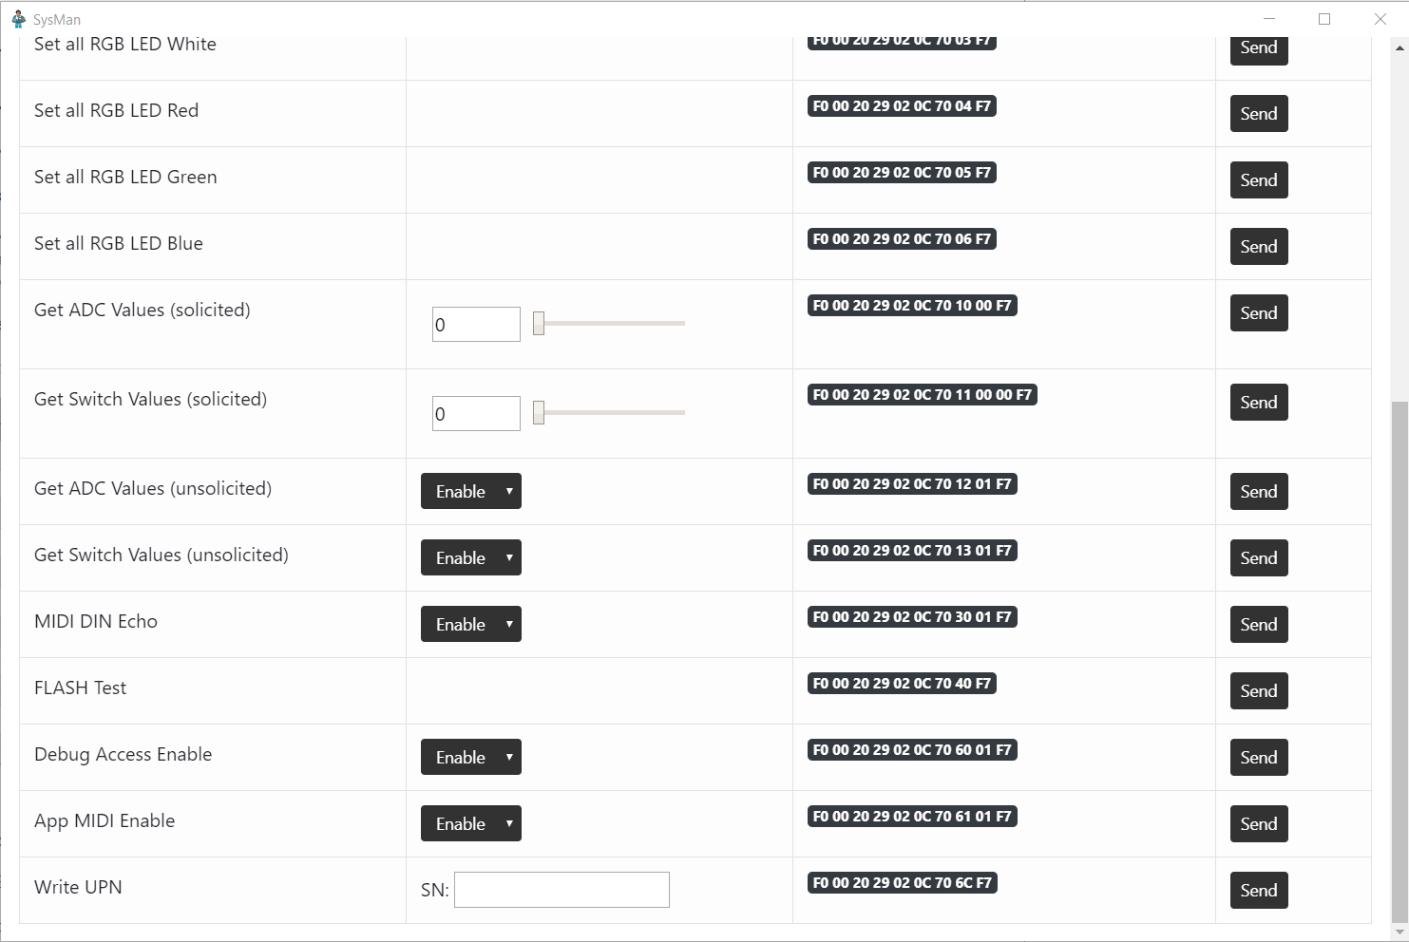
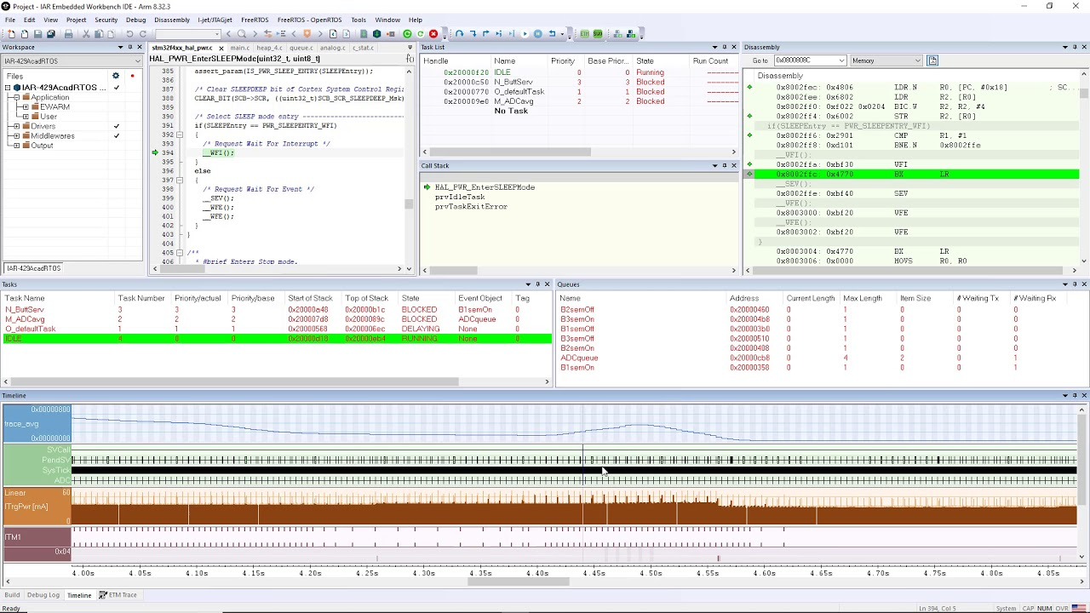
Finding out what’s going on inside

Slide 19

Implement Reliable Field Update

Slide 20
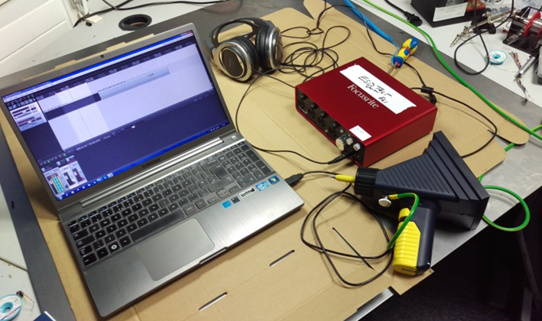
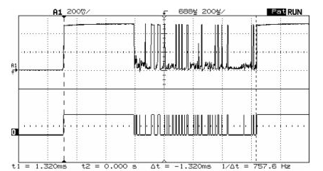
The real world looks a bit funny
From Jack Ganssle’s blog – worth checking out!

Slide 21

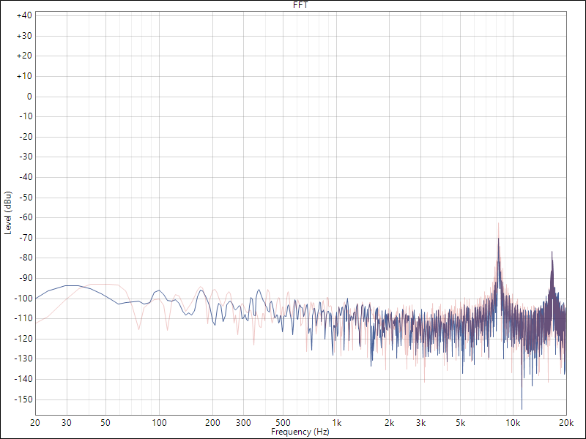
Sometimes we cause the problems for ourselves
Notes:
Stock image from pixabay, free to use without attribution https://pixabay.com/photos/city-people-cable-tangled-cables-3261202/

Slide 22
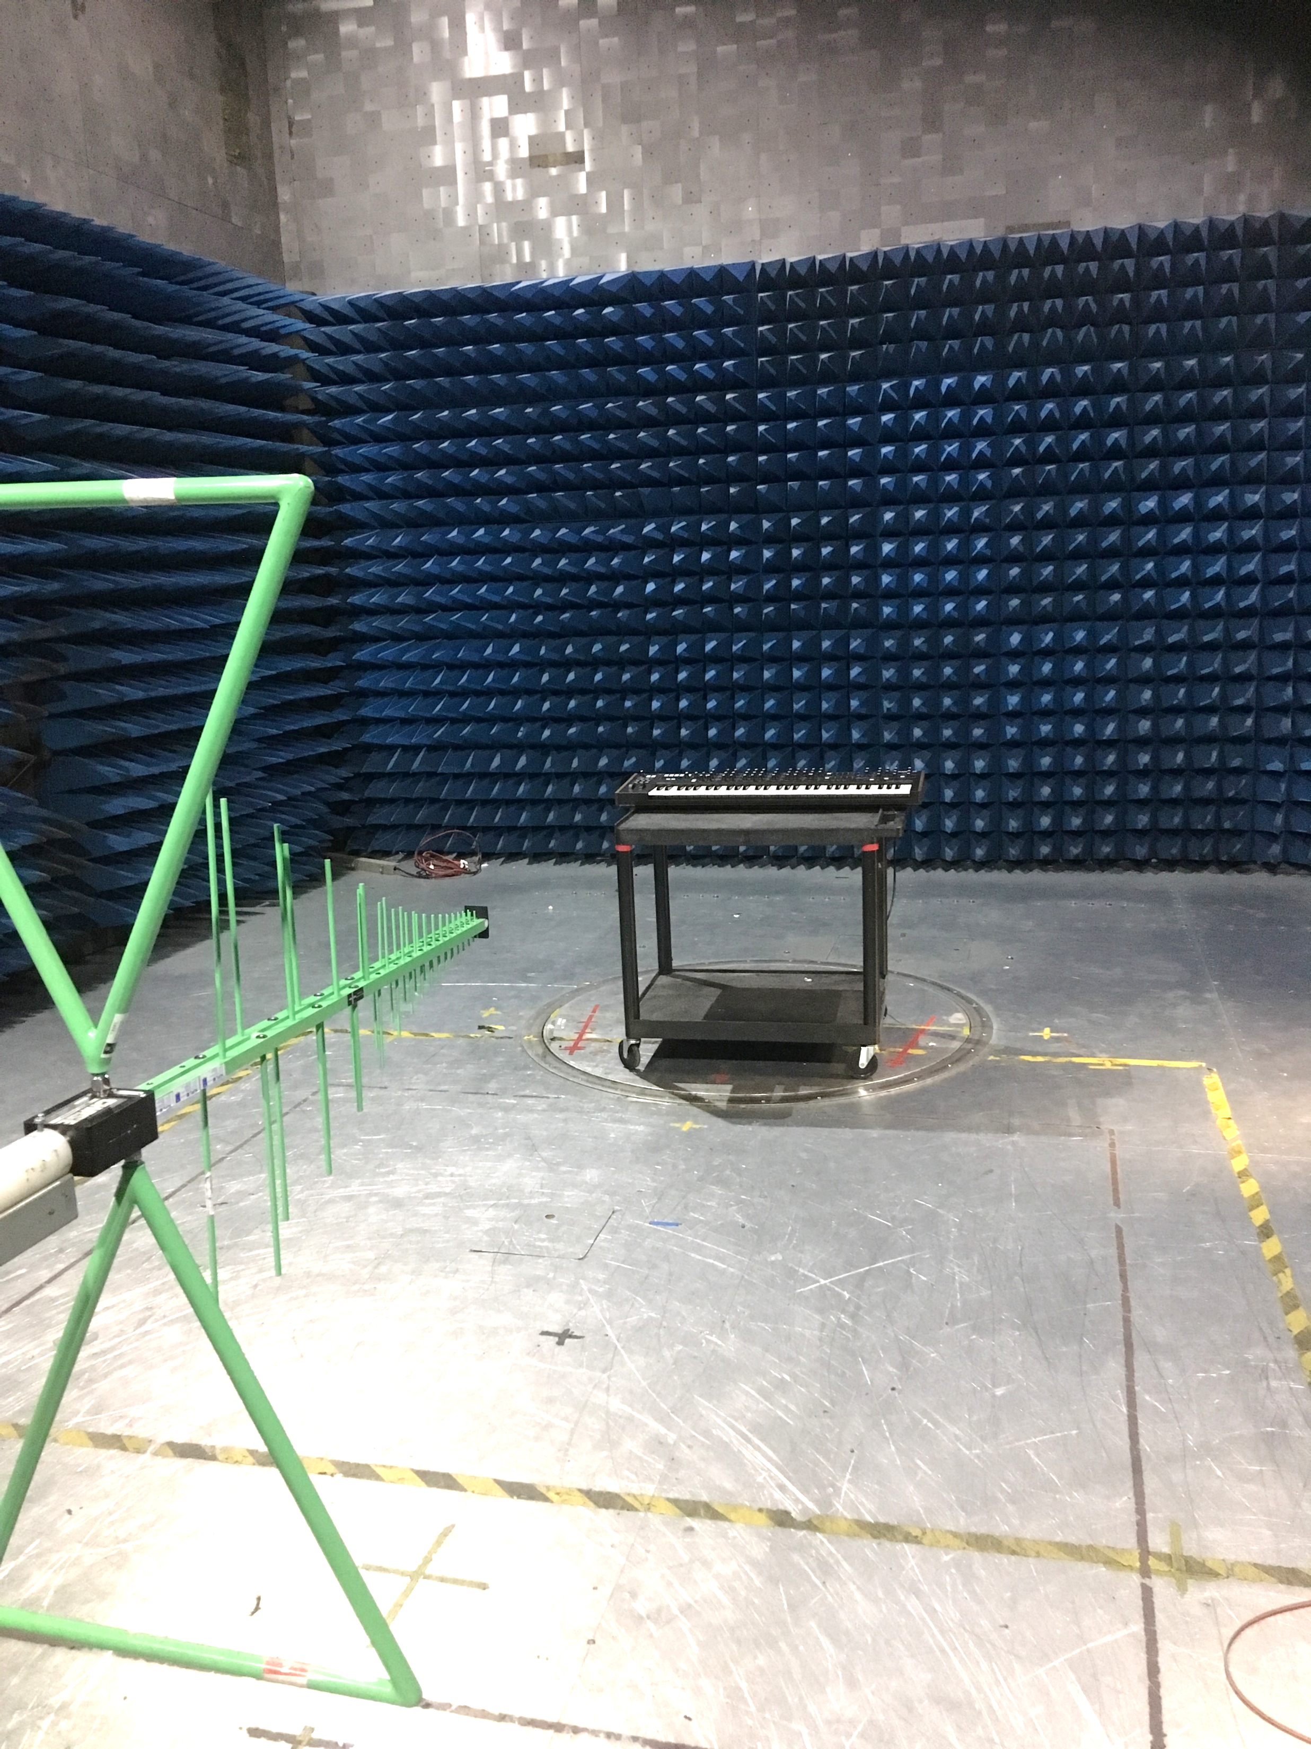
Playing nicely with others

Slide 23



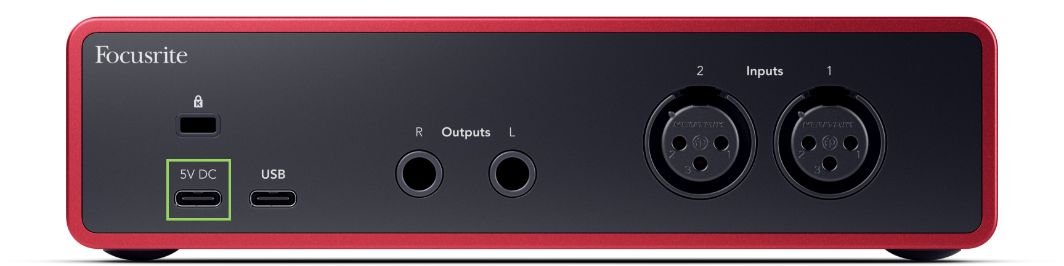


Standards help, but the goal is a good user experience

Slide 24

Embedded Software Development
A wild ride!

Slide 25
We're Hiring!

